Slide 1
Distributed Transactions
From
George Coulouris Material

Slide 2
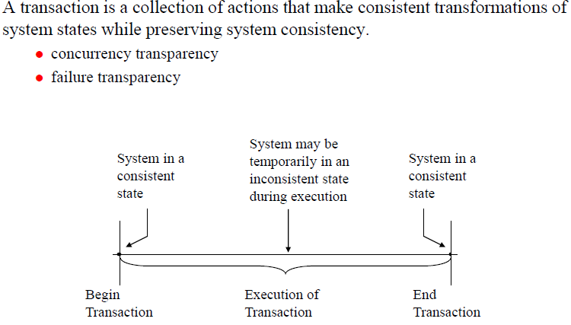
Transaction

Slide 3
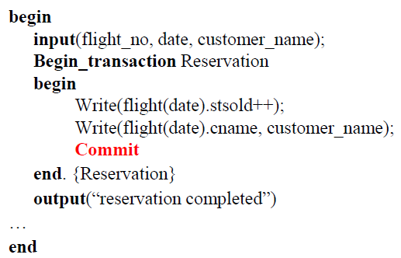
Example of Transaction

Slide 4
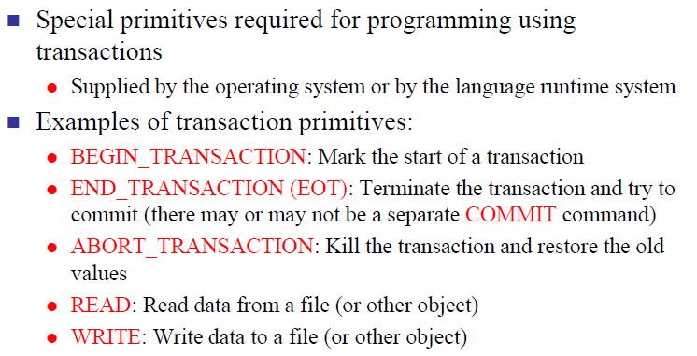
Transaction Primitives

Slide 5
Operations of the Account interface
deposit(amount)
deposit amount in the account
withdraw(amount)
withdraw amount from the account
getBalance() -> amount
return the balance of the account
setBalance(amount)
set the balance of the account to amount
Operations of the Branch interface
create(name) -> account
create a new account with a given name
lookUp(name) -> account
return a reference to the account with the given name
branchTotal() -> amount
return the total of all the balances at the branch

Slide 6
Enhancing Client Cooperation by Signaling
Clients may use a server as a means of sharing some resources. E.g. some clients update the server’s objects and other clients access them.
However, in some applications, threads need to communicate and coordinate their actions.
Producer and Consumer problem.
Wait and Notify actions.

Slide 7
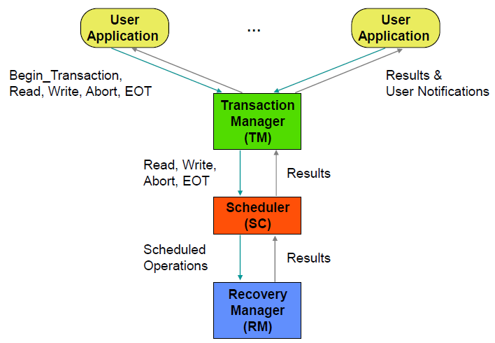
Centralized Transaction Execution

Slide 8
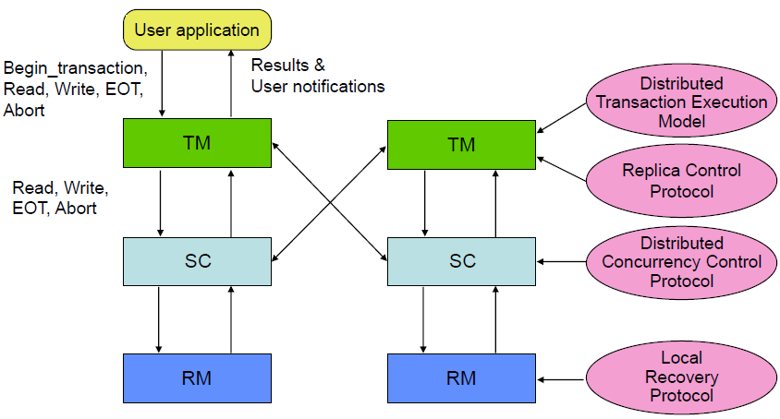
Distributed Transaction Execution

Slide 9
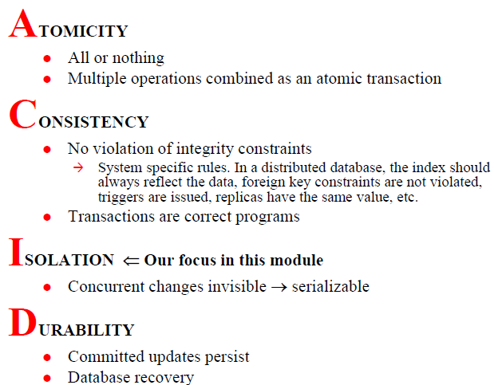
Properties of Transactions

Slide 10
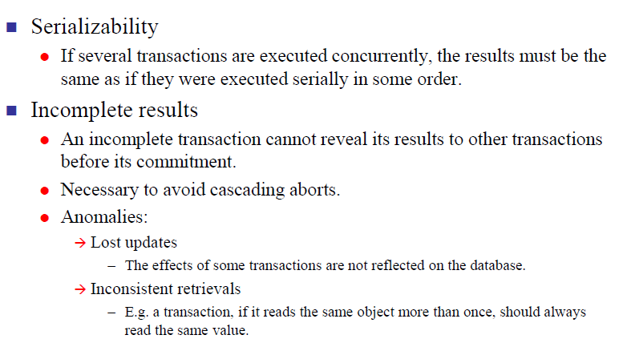
Serializability of Transactions

Slide 11
Introduction to Transaction Processing (6)
Why Concurrency Control is needed:
The Lost Update Problem
This occurs when two transactions that access the same database items have their operations interleaved in a way that makes the value of some database item incorrect.
The Temporary Update (or Dirty Read) Problem
This occurs when one transaction updates a database item and then the transaction fails for some reason
The updated item is accessed by another transaction before it is changed back to its original value.
The Incorrect Summary Problem
If one transaction is calculating an aggregate summary function on a number of records while other transactions are updating some of these records, the aggregate function may calculate some values before they are updated and others after they are updated.

Slide 12
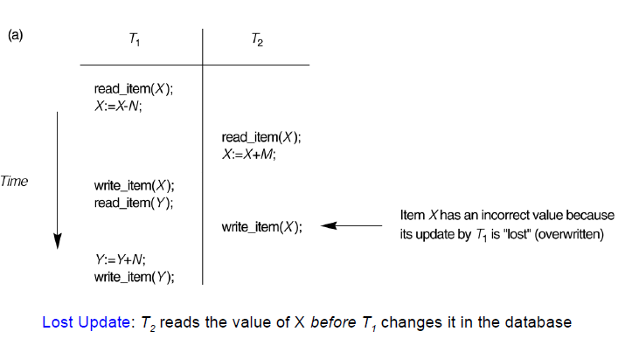
Concurrent execution is uncontrolled: (a) The lost update problem.

Slide 13
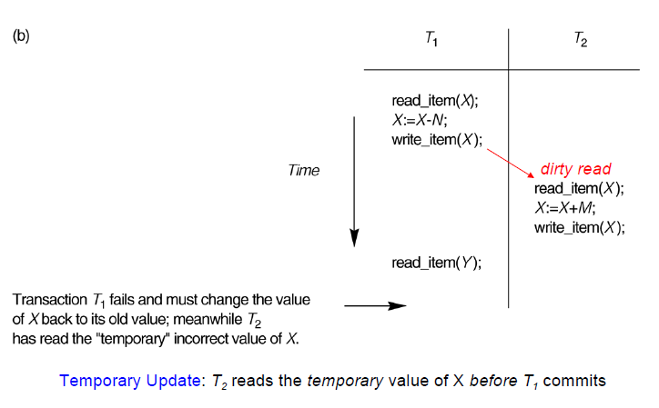
Concurrent execution is uncontrolled: (b) The temporary update problem.
Commit
Abort
Rollback

Slide 14
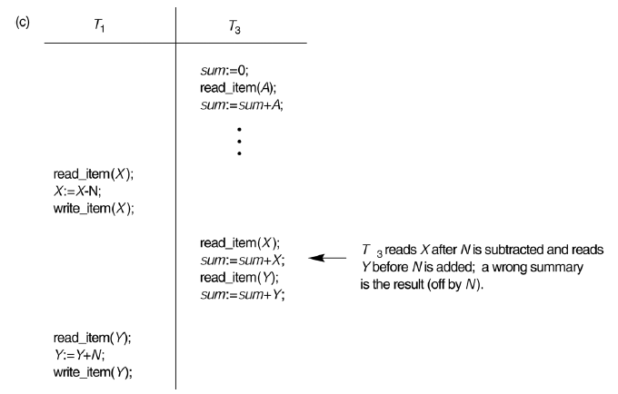
Concurrent execution is uncontrolled: (c) The incorrect summary problem.

Slide 15
Serially Equivalent
If these transactions are done one at a time in some order, then the final result will be correct.
If we do not want to sacrifice the concurrency, an interleaving of the operations of transactions may lead to the same effect as if the transactions had been performed one at a time in some order.
We say it is a serially equivalent.
The use of serial equivalence is a criterion for correct concurrent execution to prevent lost updates and inconsistent retrievals.

Slide 16
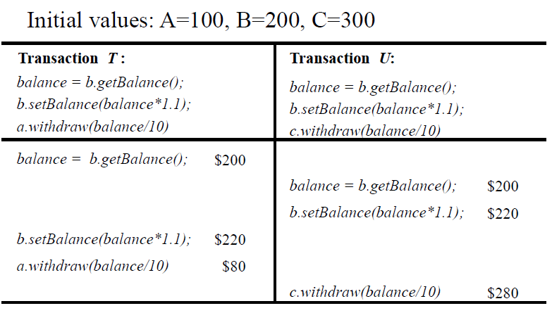
Concurrency Control – Lost Update Problem
a, b and c initially have bank account balance are: 100, 200, and 300. T transfers an amount from a to b. U transfers an amount from c to b.
b is increased by 10% on its balance in each. Totally 20 % hike

Slide 17
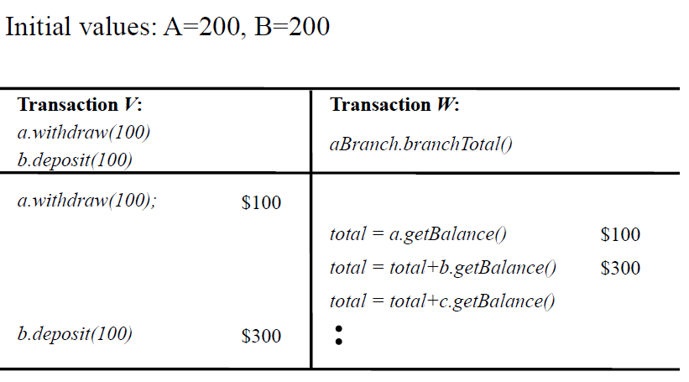
Concurrency Control – Inconsistent Retrieval Problem

Slide 18
A serially equivalent interleaving of T and U
Transaction
T
:
Transaction
U
:
balance = b.getBalance()
balance = b.getBalance()
b.setBalance(balance*1.1)
b.setBalance(balance*1.1)
a.withdraw(balance/10)
c.withdraw(balance/10)
balance = b.getBalance()
$200
b.setBalance(balance*1.1)
$220
balance = b.getBalance()
$220
b.setBalance(balance*1.1)
$242
a.withdraw(balance/10)
$80
c.withdraw(balance/10)
$278

Slide 19
A serially equivalent interleaving of V and W
Transaction
V
:
Transaction
W
:
a.withdraw(100);
aBranch.branchTotal()
b.deposit(100)
a.withdraw(100);
$100
b.deposit(100)
$300
total = a.getBalance()
$100
total = total+b.getBalance()
$400
total = total+c.getBalance()
...

Slide 20
Read and write operation conflict rules
Operations of different
Conflict
Reason
transactions
read
read
No
Because the effect of a pair of
read
operations
does not depend on the order in which they are
executed
read
write
Yes
Because the effect of a
read
and a
write
operation
depends on the order of their execution
write
write
Yes
Because the effect of a pair of
write
operations
depends on the order of their execution

Slide 21
A non-serially equivalent interleaving of operations of transactions T and U
Transaction
T
:
Transaction
U
:
x = read(i)
write(i, 10)
y = read(j)
write(j, 30)
write(j, 20)
z = read (i)
Access to objects i & j are serial, but transactions are not serially equivalent

Slide 22
Solutions to Concurrency control problems
Locks used to order transactions that access the same object according to request order.
Optimistic concurrency control allows transactions to proceed until they are ready to commit, whereupon a check is made to see any conflicting operation on objects.
Timestamp ordering uses timestamps to order transactions that access the same object according to their starting time

Slide 23
A dirty read when transaction T aborts
Transaction
T
:
Transaction
U
:
a.getBalance()
a.getBalance()
a.setBalance(balance + 10)
a.setBalance(balance + 20)
balance = a.getBalance()
$100
a.setBalance(balance + 10)
$110
balance = a.getBalance()
$110
a.setBalance(balance + 20)
$130
commit transaction
abort transaction

Slide 24
Recoverability of Transactions
The strategy for recoverability is to delay commits until after the commitment of any other transaction whose uncommitted state has been observed.
In our example, U delays its commit until after T commits.
In the case that T aborts, then U must abort as well

Slide 25
Cascading aborts
Abort of one transaction will cause other transactions to abort.
Transactions are only allowed to read objects that were written by committed transactions.
To ensure that this is the case, any read operation must be delayed until other transactions that applied a write operation to the same object have committed or aborted.

Slide 26
Overwriting uncommitted values or Pre-mature Writes
Transaction
T
:
Transaction
U
:
a.setBalance(105)
a.setBalance(110)
$100
a.setBalance(105)
$105
a.setBalance(110)
$110
Before Image : 100
Before Image : 105

Slide 27
Overwriting uncommitted values or Pre-mature Writes
Strict Execution of Transactions:
If the transaction delays both read and write operations on an object until all transactions that previously wrote that object have either committed or aborted.
Tentative Version: Make changes to tentative versions of objects. If transaction commits, transfer updates to objects, else delete tentative version.

Slide 28
Nested transactions
Nested transactions extend the above transaction model by allowing transactions to be composed of other transactions.
Thus several transactions may be started from within a transaction.

Slide 29
Nested transactions
T : top-level transaction
T
1
= openSubTransaction
T
= openSubTransaction
2
commit
T
1
:
T
2
:
openSubTransaction
openSubTransaction
openSubTransaction
prov. commit
abort
T
:
T
:
T
21
:
11
12
openSubTransaction
prov. commit
prov. commit
prov. commit
T
:
211
prov.commit

Slide 30
Nested transactions
Subtransactions at one level (and their descendants) may run concurrently with other subtransactions at the same level in the hierarchy.
Subtransactions can commit or abort independently.

Slide 31
Nested transactions
The rules for committing of nested transactions
A transaction may commit or abort only after its child transactions have completed.
When a subtransaction completes, it makes an independent decision either to commit provisionally or to abort. Its decision to abort is final.
When a parent aborts, all of its subtransactions are aborted.

Slide 32
Nested transactions
When a subtransaction aborts, the parent can decide whether to abort or not.
If the top-level transaction commits, then all of the subtransactions that have provisionally committed can commit too, provided that none of their ancestors has aborted.

Slide 33
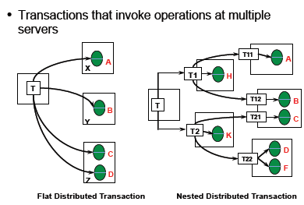
Distributed Transactions

Slide 34
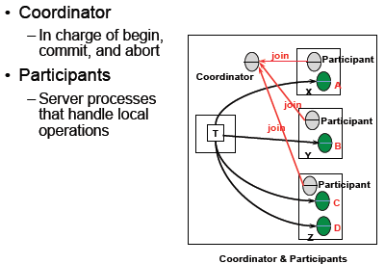
Distributed Transactions

Slide 35
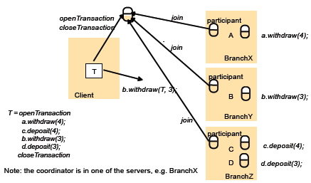
Distributed Transactions - Example

Slide 36
Thank You

